Slide 1
Docking small molecules with Autodock^{tm}
Elon Yariv
Graduate student in Prof. Nir Ben-Tal’s lab
Department of Biochemistry and Molecular Biology, Tel Aviv University

Slide 2
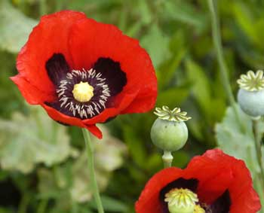
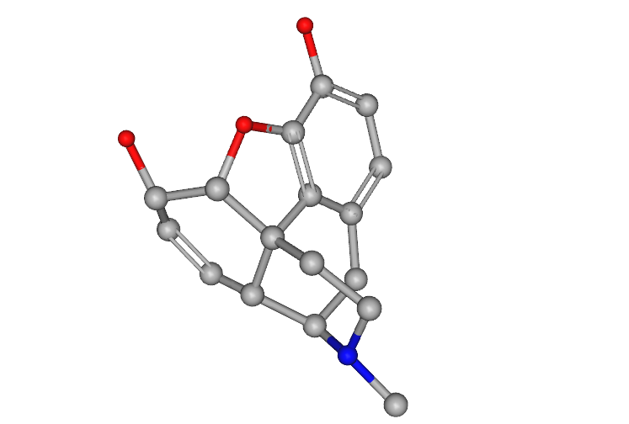
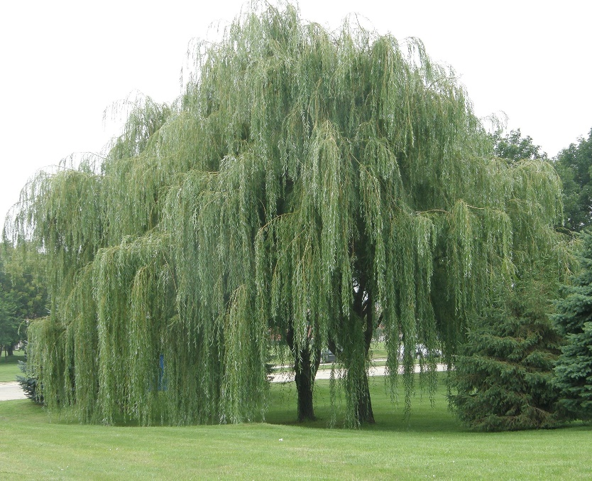
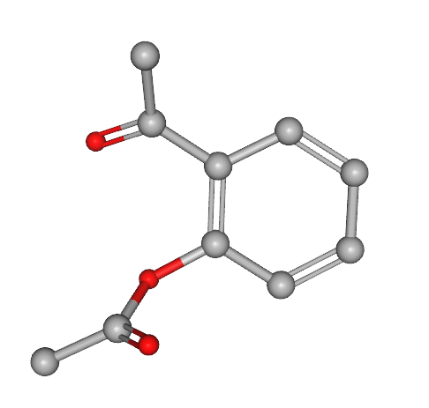
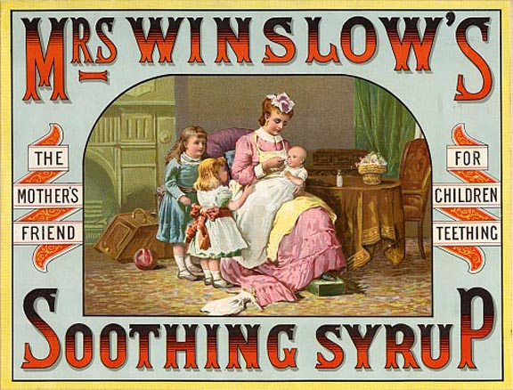
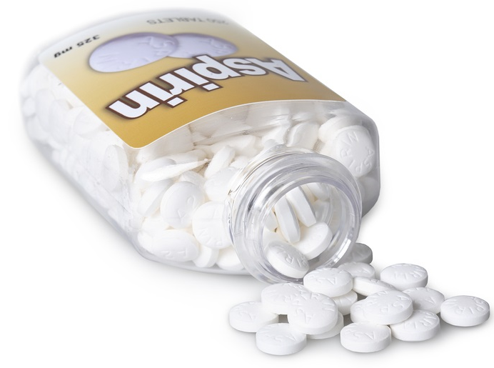
Nature is the source of many new drugs.
They can be natural products or mimetic molecules.
Almost half of the new chemical entities in the last 40 years are related to natural sources.
Opium
Aspirin
Poppy Plant Latex
Willow Tree Bark
Notes:
In the past, drug discovery focused on purifying natural compounds already known to have a pharmaceutical effect. This effect has been found in most cases to result from binding of these compounds to proteins and changing their activity.

Slide 3
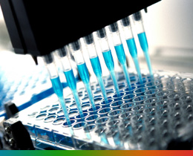
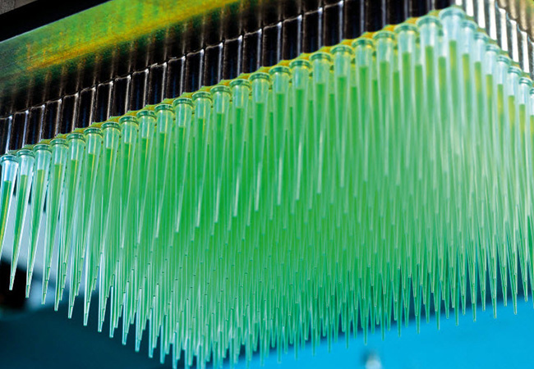
High-Throughput Drug Screening (HTS)
Notes:
Today, we know million of organic molecules that have potential of binding to proteins, which means they have a pharmaceutical potential. Therefore, current drug discovery focuses on screening these molecules to find those that act on a known protein target.

Slide 4
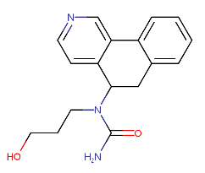
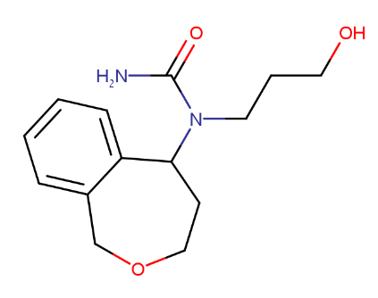
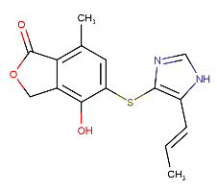
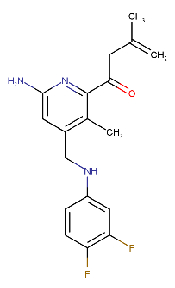
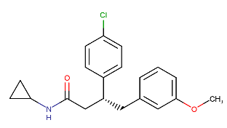
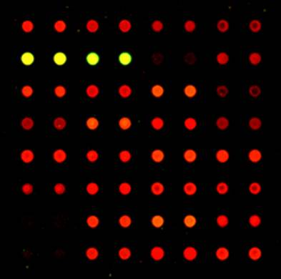
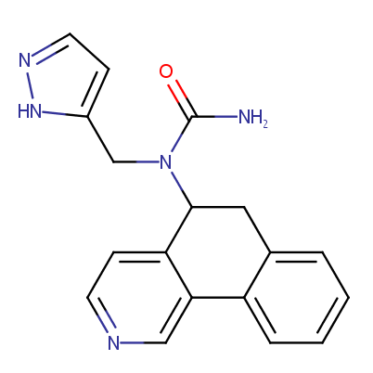
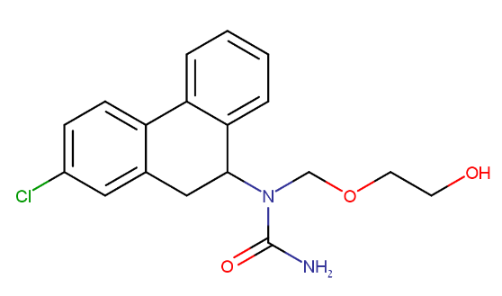
20000 compounds
Combinatorial Library Screen
100 Compounds
Hit Identification
4 Compounds
Lead discovery
Lead Optimization
60 Compounds
Validation of
HTS hits
Synthesis of analogs
Binding Assays
Activity Assays
Notes:
The traditional screening process involves developing a lab assay that measures either the binding of the molecules to the target protein, or the biological effect of the molecule as a result of the binding. However, it is not always easy to develop such an assay, and when millions of molecules have to be screened, the process is lengthy, expensive, and inefficient.

Slide 5
Limitation of HTS
Expensive & wasteful
Finding a suitable assay is difficult.

Slide 6
Average success rate: 10% of screening hits
Virtual Screening
Most common use of docking is in virtual screening.
Dock each compound in the combinatorial library.
Can screen millions to tens of millions of small molecules.

Slide 7
What is molecular docking?
Determine the position and orientation of small molecule (ligand) inside receptor.
Receptor is usually a protein, but can also be polynucleotide.

Slide 8
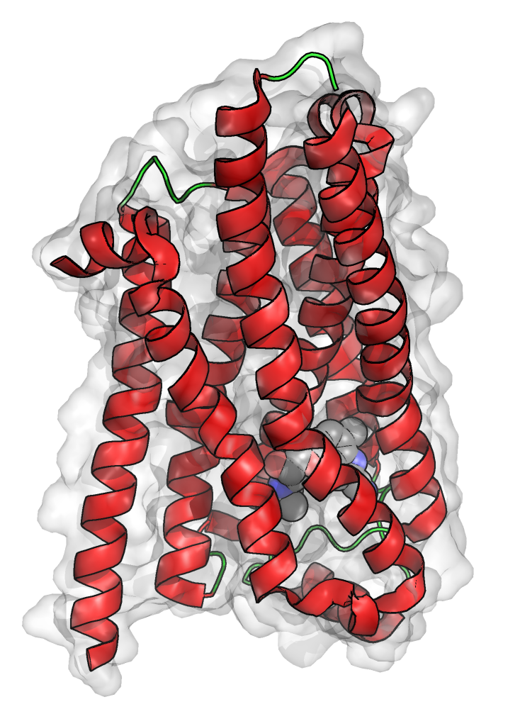
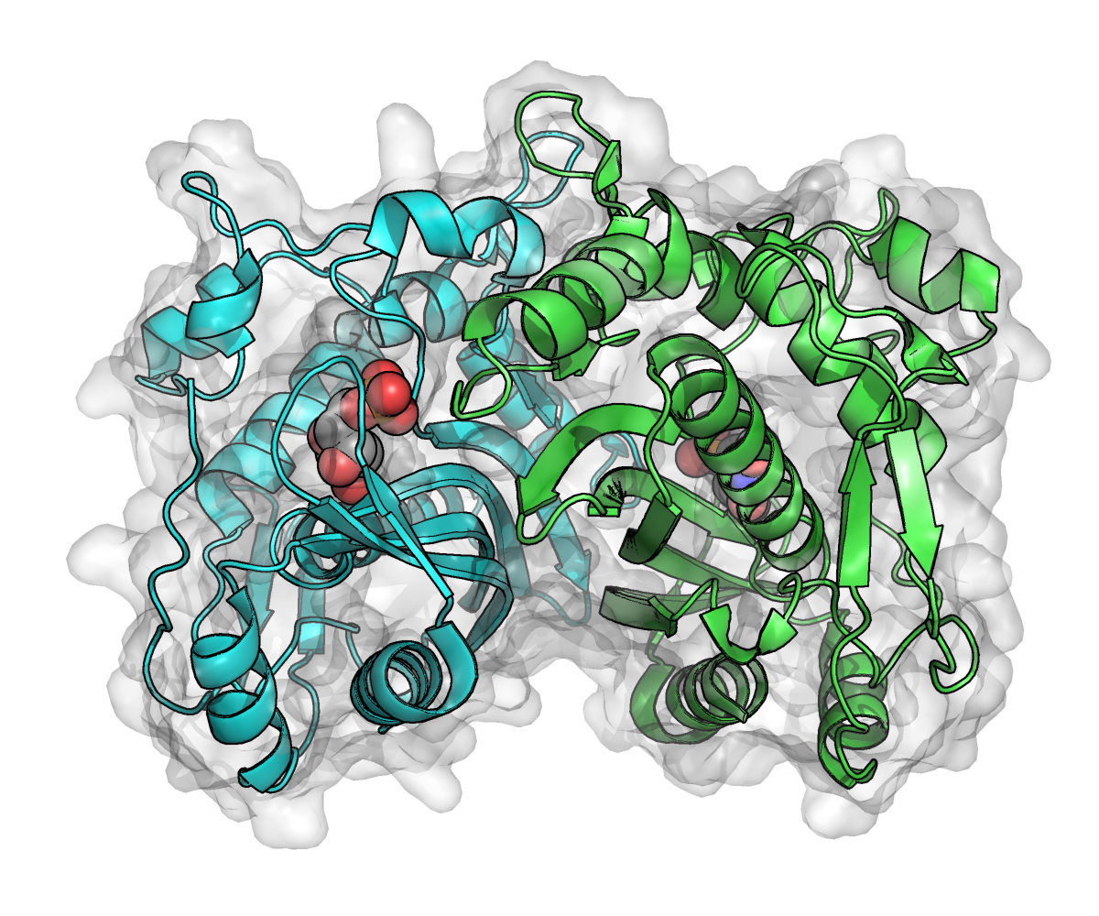
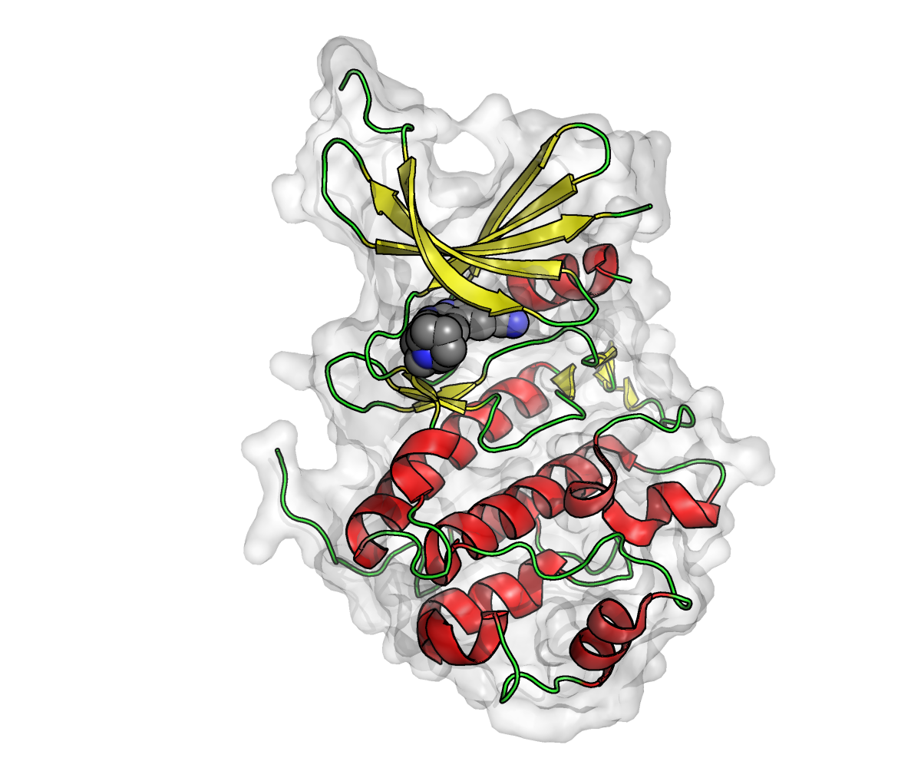
The Receptor
Requires high resolution 3 dimensional structure of the receptor.
Better then 4Å resolution structure.
X-ray crystallography is the most common source.
ThyA
AchE
β1AR
Notes:
If the resolution of the structure is worse then 3Å, the amino acid sidechains are difficult to discern.
The backbone might be placed with confidence, but the sidechains position can be uncertain.

Slide 9
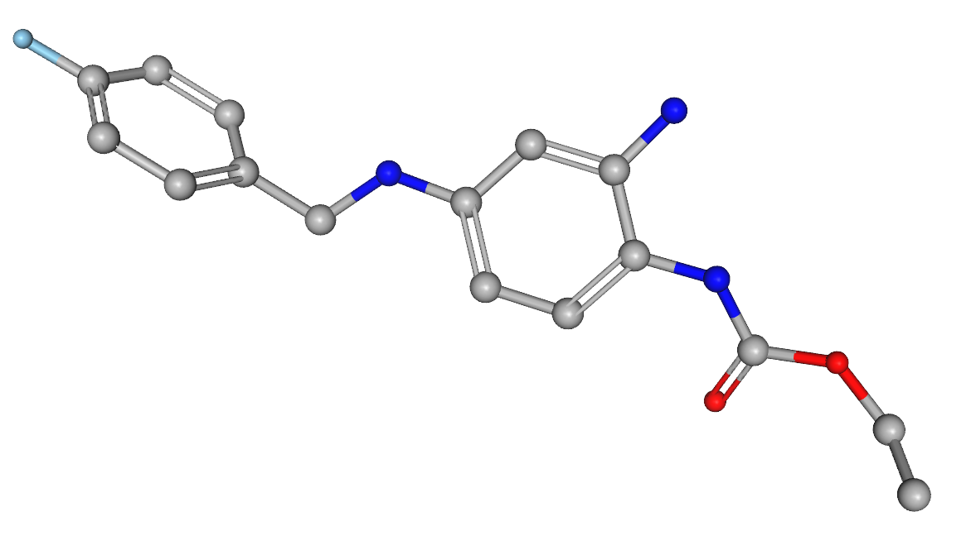
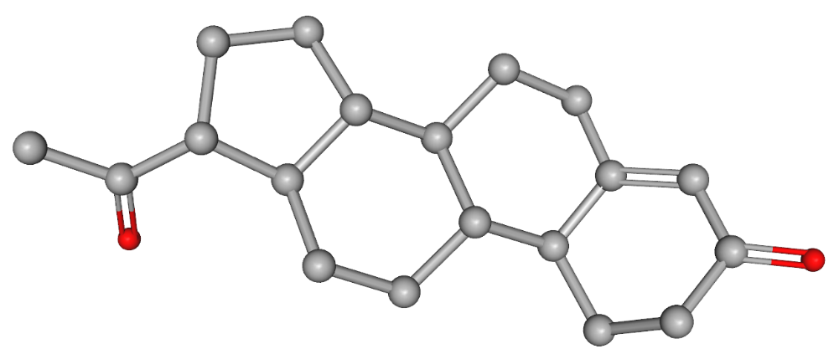
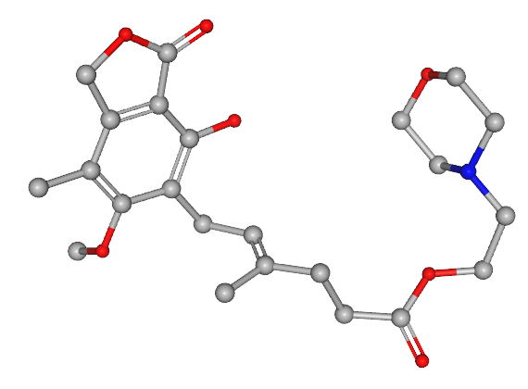
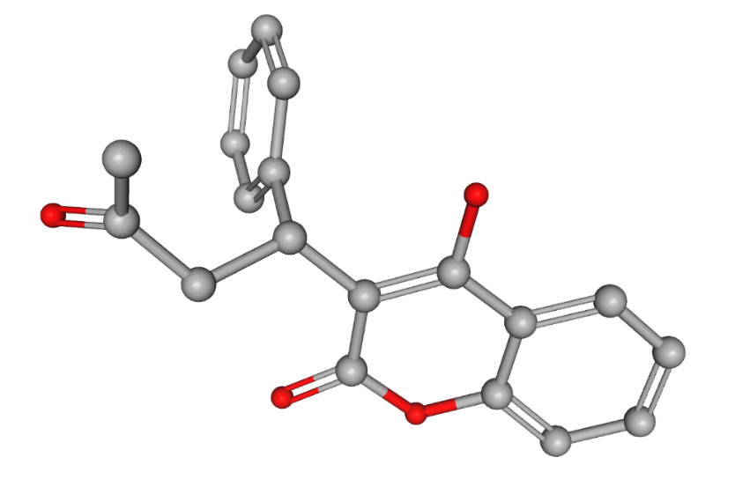
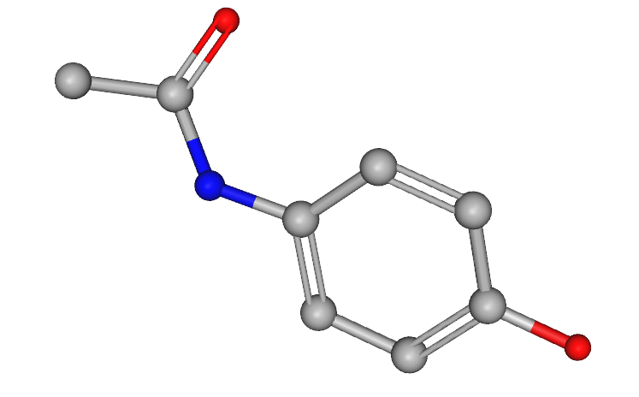
The Ligand
Small molecules – less then ~500Da.
Rigid – fewer then 9 rotatable bonds.
Ring
Rotatable
Amide
Retigabine
303Da
Progesterone
314Da
Double-bond
Morphine
285Da
Paracetamol
Mycophenolate
Warfarin (Coumadin)
151Da
308Da
433Da
Notes:
What molecules can we work with?
Drug molecules tend to be small and rigid.
Docking excels at determining binding pose of compounds with drug-like proprieties.
Lipinski’s rule for drug-likeness:
<500Da
<10 Hydrogen bond acceptors
<5 Hydrogen bond donors.

Slide 10
Most cited molecular docking program
Available Docking Programs
Commercial: FlexX, Gold, Sybyl, Glide, LIBdock…
Open-source/free for academics: Autodock, Dock
Autodock is developed by:
Dr. Arthur J. Olson
Molecular Graphics lab
The Scripps Research Institute, California, USA.
Notes:
Many available docking programs.
Most need to be purchased and only few can be obtained without payment.
Each program uses unique algorithms, but they have many similarities in their basic approach.
No one program can be said to be superior, though all claim to be!

Slide 11
Receptor Grid Generation
Conformational Sampling
Ranking and Scoring
Docking Algorithm
Notes:
Overview of the docking algorithm.
Most docking algorithms can be divided into these three steps.
Receptor grid – A simplified representation of the receptor. Necessary to save computational time.
Conformational sampling – Each ligand molecules has an innumerable amount of conformations.
Most do not fit the receptor and only a few represent the conformation in which the ligand sits inside it’s receptor.
Ranking and Scoring – Each ligand conformation must be evaluated.
Autodock uses a scoring function which approximates the enthalpy energy of binding.

Slide 12
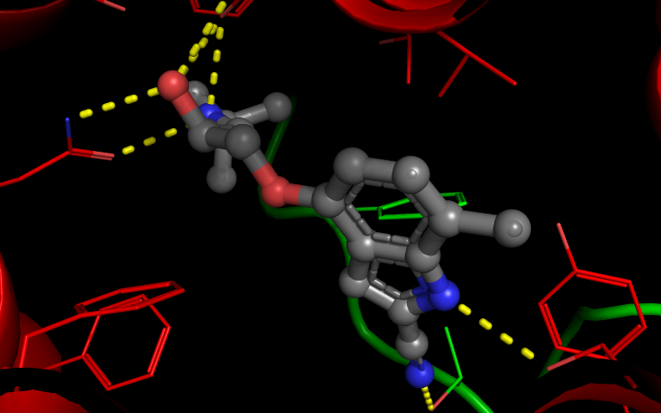
Receptor Grid Generation
Receptor Grid Generation
Conformational Sampling
Ranking and Scoring
Problem: Need to evaluate countless conformations per ligand.
Solution: Score poses by comparing coordinates to values in grid table.
Notes:
Receptor Grid Generation.
Countless of conformations for a single ligand. Impractical to measure all the interactions between the receptor and ligand for each and every conformation.
This is especially true for simulations that dock tens or hundreds of thousands of molecules within few hours.
In such instances the procedure for each ligand cannot last more then a few seconds.
The grid is simplified representation of the ligand binding site within the receptor.
It is in essence is the negative of the protein.

Slide 13
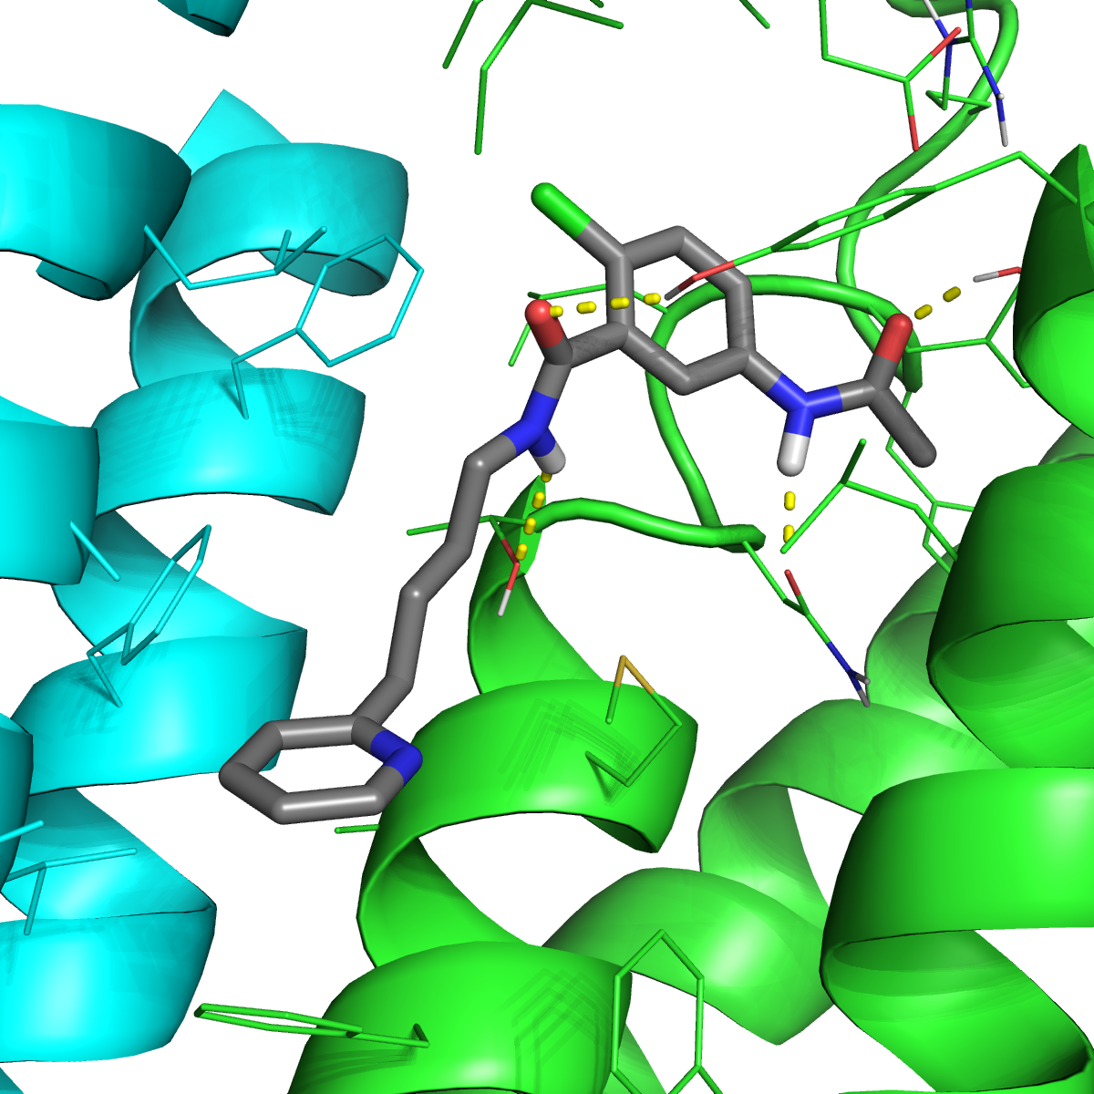
Determines binding site dimensions.
Determines accessible area.
Defines active groups in binding site.
Breaks down continuous space into discrete points.

Slide 14
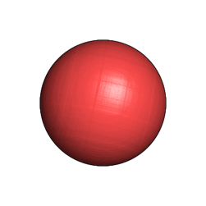
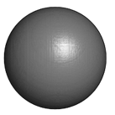
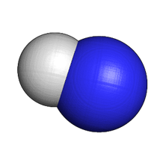
C
:O
Hydrogen
Bond Acceptor
Hydrophobic
H
Hydrogen
Bond Donor
Notes:
The grid defines the penalty or positive score that is given to a ligand atom found in certain coordinates. The entire grid is a table of penalties/positive interactions.
The evaluation of ligand pose (conformation within the receptor) is thereby reduced to a simple comparison between the ligand coordinates, and the receptor grid table.
The grid is limited to a box around the binding site – to reduce the irrelevant search space.
The area inside the box is split into grid of points.
In each of these points an atom is placed, and it’s interaction energy evaluated.
This procedure is repeated for each atom type within the ligand that will be docked.

Slide 15
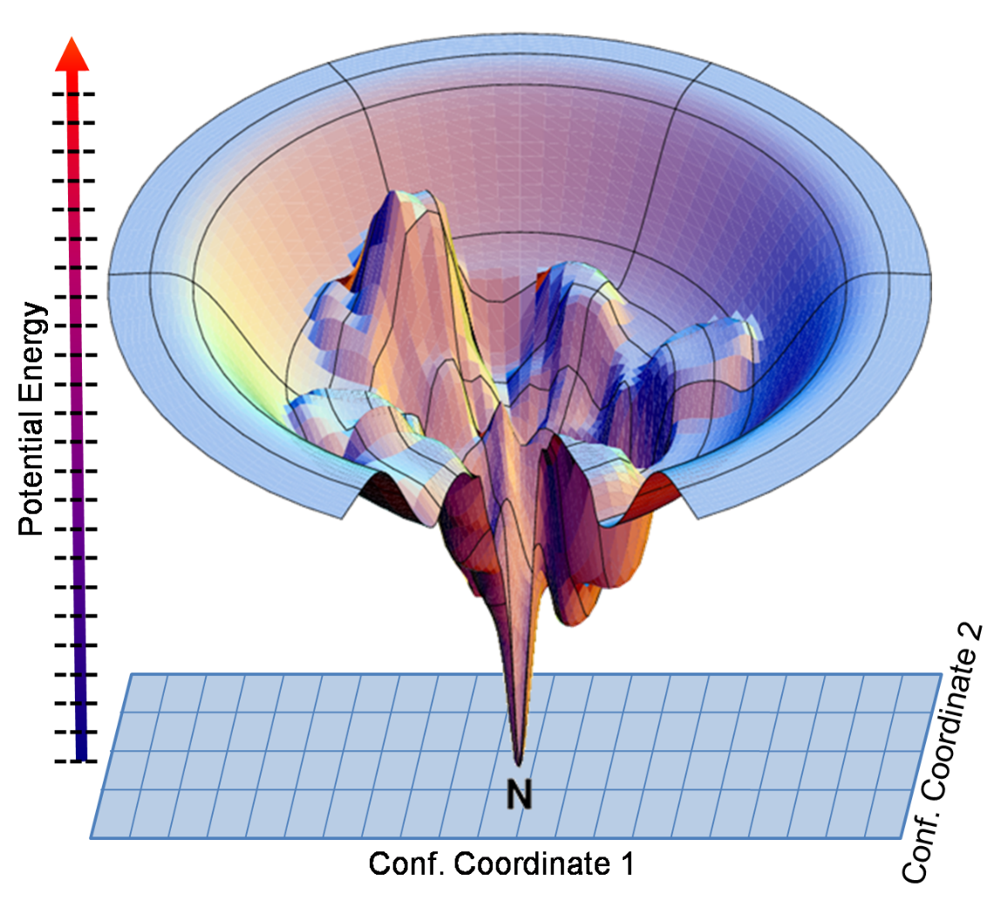
Conformational Sampling
Receptor Grid Generation
Conformational Sampling
Ranking and Scoring
Generate different ligand conformations. The different coordinates generated are then compared to the grid.
Notes:
Stochastic Sampling – Starts with a random ligand conformation/conformations. In each step of the simulation the conformation is altered and reevaluated.
If enough steps are made these methods may sample all the conformational space, and find the most energetically favored pose – the global energy minimum!
However, these simulations are also time consuming and comparatively slow.
A possible drawback of such methods is that the simulation might get stuck inside a local minimum – a conformation which any change to it would decrease the binding affinity, but its not the most stable pose.

Slide 16
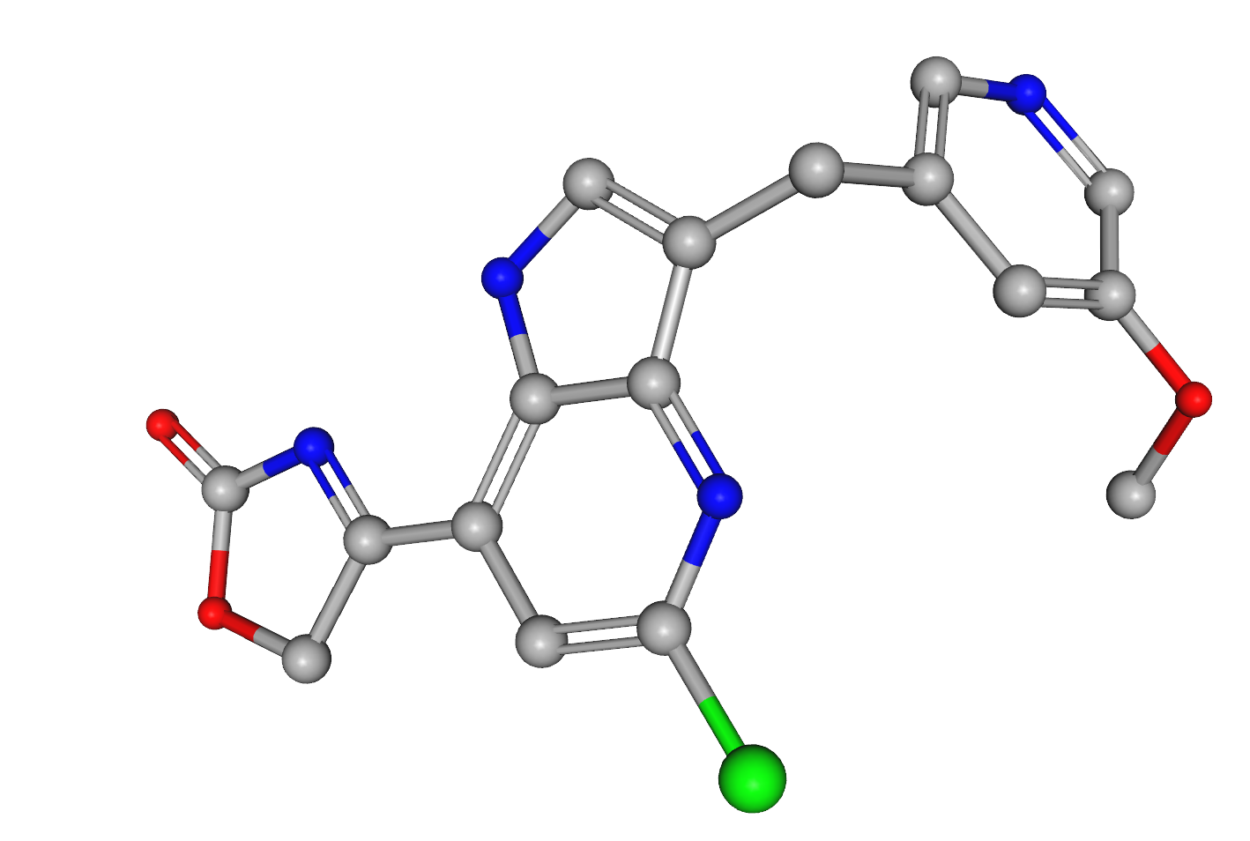
Translation
Torsion
Rotation
Notes:
Types of changes in the ligand.
Translational – Rigid movement of the ligand inside the receptor, without changing its orientation.
Rotational – Rotate the ligand in place.
Torsional – Rotate a single bond in the ligand. Rings, double bonds and amides are excluded.

Slide 17
Stochastic Sampling
Simulated annealing – Start by roughly sampling the entire conformation space. As simulation proceeds, minimize the searched region to the global minimum.
Genetic algorithm – Population of conformation which replicate each generation. In each generation there is a chance of mutation – the introduction of a novel conformation.
Lamarckian Genetic algorithm – Mutation isn’t random, but directed down the energy gradient.
Notes:
Stochastic Sampling – Starts with a random ligand conformation/conformations. In each step of the simulation the conformation is altered and reevaluated.
If enough steps are made these methods may sample all the conformational space, and find the most energetically favored pose – the global energy minimum!
However, these simulations are also time consuming and comparatively slow.
A possible drawback of such methods is that the simulation might get stuck inside a local minimum – a conformation which any change to it would decrease the binding affinity, but its not the most stable pose.
Similar to population genetics evolutionary model.
Starts with a “population” of ligand conformations. Each generation a conformation may double itself and new conformations may be introduced through permutation.
Favored conformations will grow in frequency and unfavorable conformations will disappear. After a set number of generations the existing conformations are recovered.
In Lamarckian genetics the mutations introduced into the structure aren’t random. The program remembers the previous changes, and chooses to alter the ligand conformation in the same direction if it is energetically favorable.

Slide 18
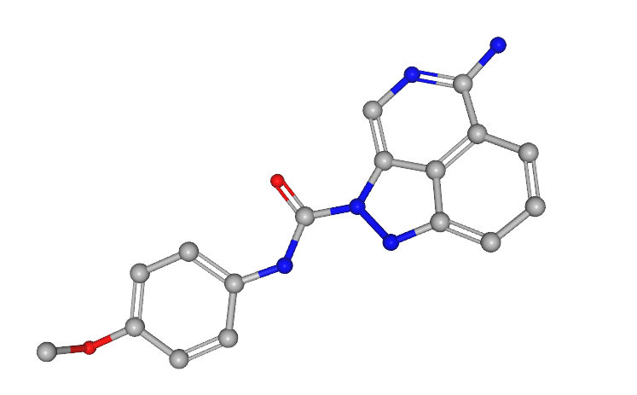
Other Sampling Methods
Exhaustive Sampling
Start with a large conformation library. Rank each. Reject low scoring conformations. Short simulations generate structures similar to best conformations. Rank & reject again.
Hook & Grow
Dock ligand core rigidly. Grow rotamers around it step by step.
Notes:
Exhaustive Sampling – Doesn’t search for the global minimum at all! Generate a large ensemble of varied ligand conformations. Score and rank each. Start short simulations to search for similar conformations. In each iteration a threshold is set, so that only the top ranking poses proceed to the next stage. In the final stage the sampling ligands are often relaxed within the receptor – clashes are reduced, and any possible strain is eased.
Hook & grow – Ligands are made of rigid fragments, and rotatable groups surrounding these fragments. Finding the optimal pose for a rigid fragment is comparatively easy.
Therefore some algorithms (Dock, Glide-XP) start by docking the largest fragment and choosing several possible positions for it. From this fragment the rotatable groups are grown one bond at a time. The fully grown ligand is then relaxed.

Slide 19
Ranking & Scoring
Receptor Grid Generation
Conformational Sampling
Ranking and Scoring
After the poses are generated, they must be ranked.
Force fields – Energy based on Newtonian physics.
Knowledge based – Energy based on large databases of structures.
Empirical energy function – Optimized to fit empirical binding results.
Notes:
In most such functions the energy attributed to binding is completely off scale when compared to empirical measurements.
The scoring function was designed in order to better distinguish correct binding poses.
It much less successful in accurately predicting binding energy.

Slide 20
Scoring Function
ΔG = Intramolecular potential + Intermolecular potential + Corrections
Bond length
Van der Waals
Solvation
Terms
Bond angle
Hydrogen Bonds
Rotatable
Bonds
Torsion
Coulomb
Autodock scoring function is a modified AMBER force field.

Slide 21
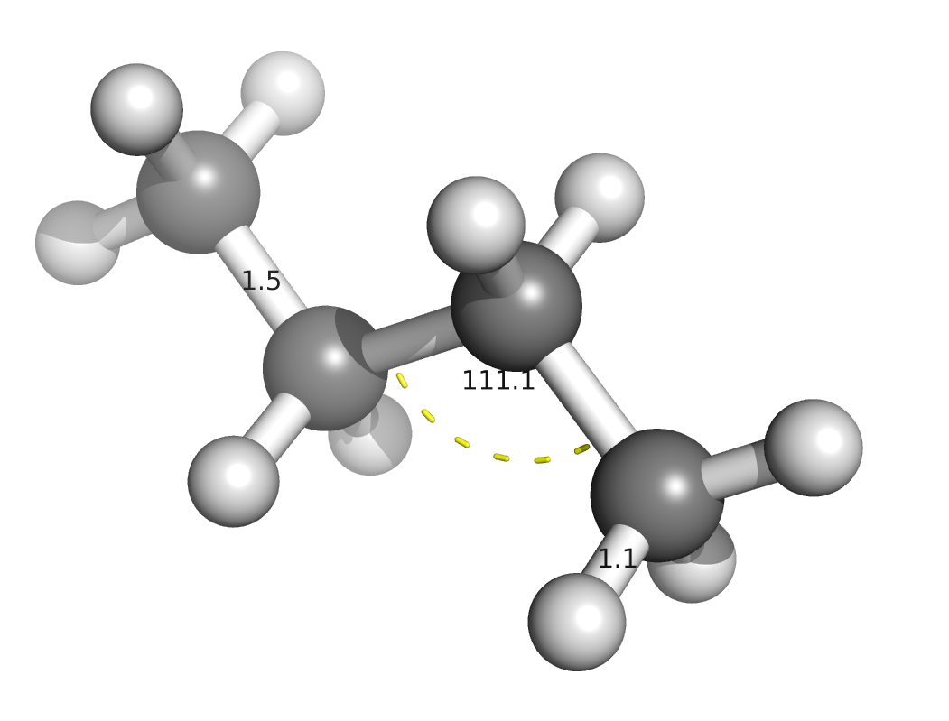
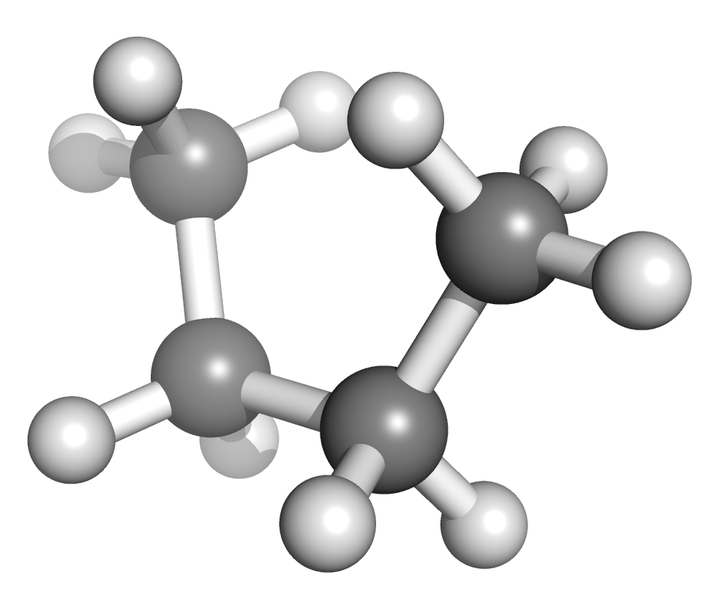
Intra-molecular forces
Bond length
Bond Angle
Dihedral
φ
Notes:
Intramolecular forces – each atom is considered as a rigid ball with a uniform charge assigned to it.
The radius of the ball is equal to vdW radius.
Bonds are considered as springs and have optimal length and angles at which they are most stable.
Divergence from the optimum will cause a penalty.

Slide 22
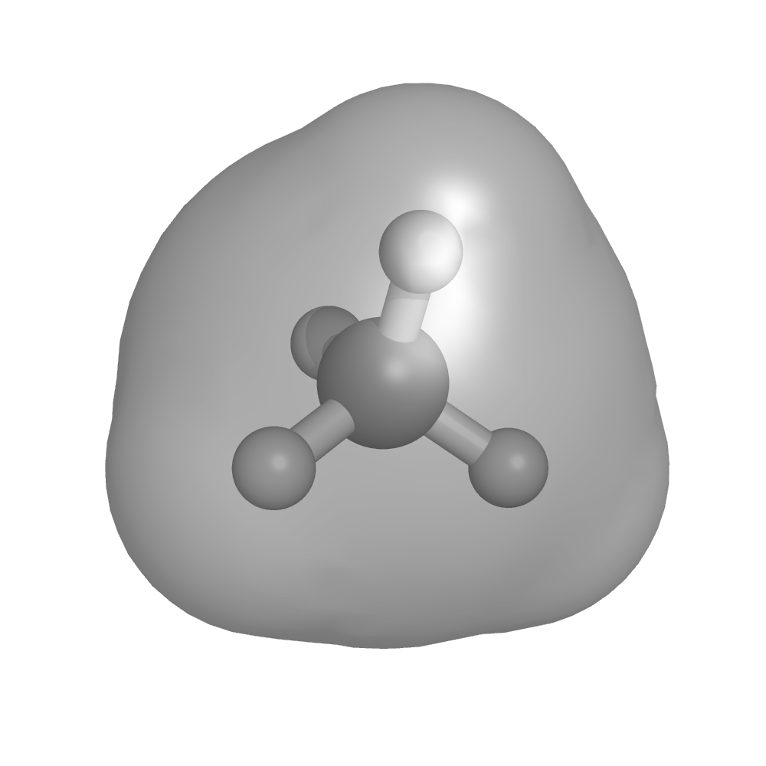
Inter-molecular forces – Van der Waals
ΔE
Steric clashes at close range cause strong repulsion.
London dispersion forces cause attraction between adjacent atoms.
Large contact area results in strong attraction.
vdW radius
r
$$E=−\frac{3}{2}\frac{I_{1}I_{2}}{I_{1}+I_{2}}\frac{α_{1}α_{2}}{R^{6}}$$
London Dispersion Forces

Slide 23
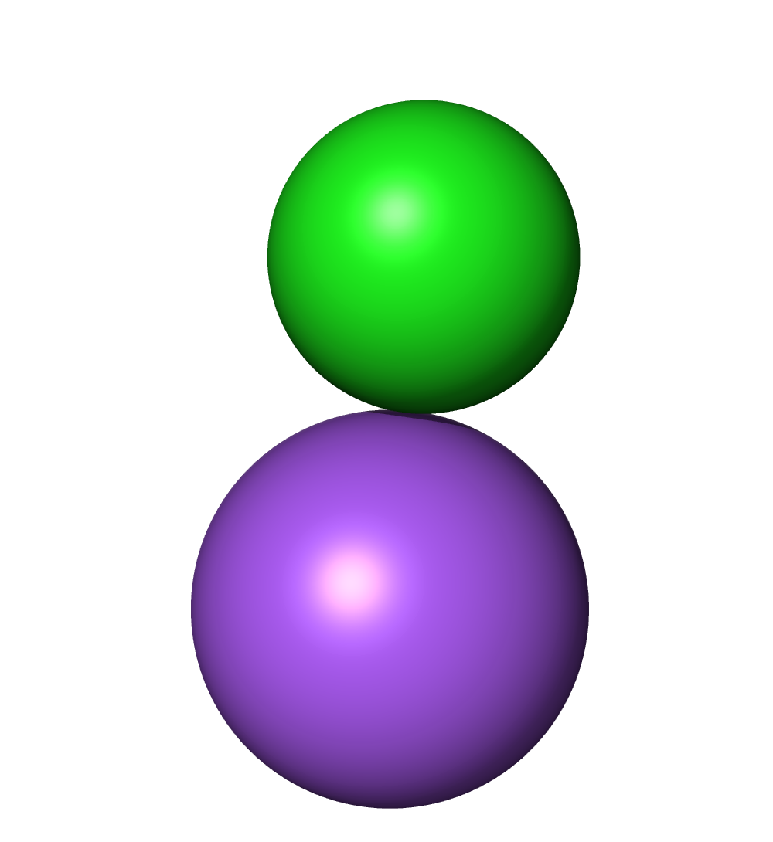
Inter-molecular forces – Polar Interactions
Na⁺
$$F_{c}=\frac{1}{4ε}\frac{q_{1}∙q_{2}}{r^{2}}$$
δ⁺
θ
<4.5Å
1.6Å-2.8Å
Coulomb Force
δ⁻
Cl⁻
ω
Salt Bridge
Hydrogen Bond
Non-directional
Long range
Dependent on donor-acceptor angle
Short range

Slide 24
Drawbacks of molecular docking
Imperfect Scoring function
Based on force fields, a schematic representation of molecular systems.
Newtonian molecular mechanics ignore Quantum physical properties of molecules.
Notes:
Atoms aren’t rigid balls. Forces between them do not adhere to classic Newtonian mechanics.
The electron density around the nucleus is given by a complex wave function.
The position of the electrons are even more difficult to determine in molecules.
The electrons aren’t locked around a single atom, their density shifts and changes.
Molecular mechanics misses important effects such as polarization due to environment.
Necessary evil (at least for now) – Quantum mechanical calculations find the electron density around the nucleus.
These calculations are computationally expensive and cannot be performed on more then a few 100 atoms.

Slide 25
Drawbacks of molecular docking
Gibbs Energy - $∆G=∆H−T∆S$
Entropy is easy to measure, but extremely difficult to calculate.
Correction terms in energy function are supposed to approximate entropy, while require very little computation.
Notes:
Correction terms try to account for:
- the entropy loss caused by constraining a ligand into a certain conformation.
- the entropy gain caused by the hydrophobic effect – release of trapped water molecules into the solvent.
Correction terms usually ignore:
- the entropy loss caused by constraining the protein into certain conformation.
If the binding site remains the same then docking can compare between different ligands.
It does mean that the scoring function can’t give an absolute binding energy.

Slide 26
Absolute Value of score is meaningless
Docking score can be used to compare different poses or ligands.

Slide 27
Drawbacks of molecular docking
Insufficient Sampling
Difficult to sample every ligand conformation possible in a short time span. The more flexible a ligand, the less effective the sampling.
The protein is usually kept completely rigid!
Partial Solution: dock into an ensemble of protein conformations.
Notes:
The method works because it is to find a local minimum in order to determine if a compound might bind the receptor.
To find the global minimum, it is possible to perform local optimization after the docking is finished.
Local optimization can be performed with molecular dynamics or Monte Carlo simulations.

Slide 28
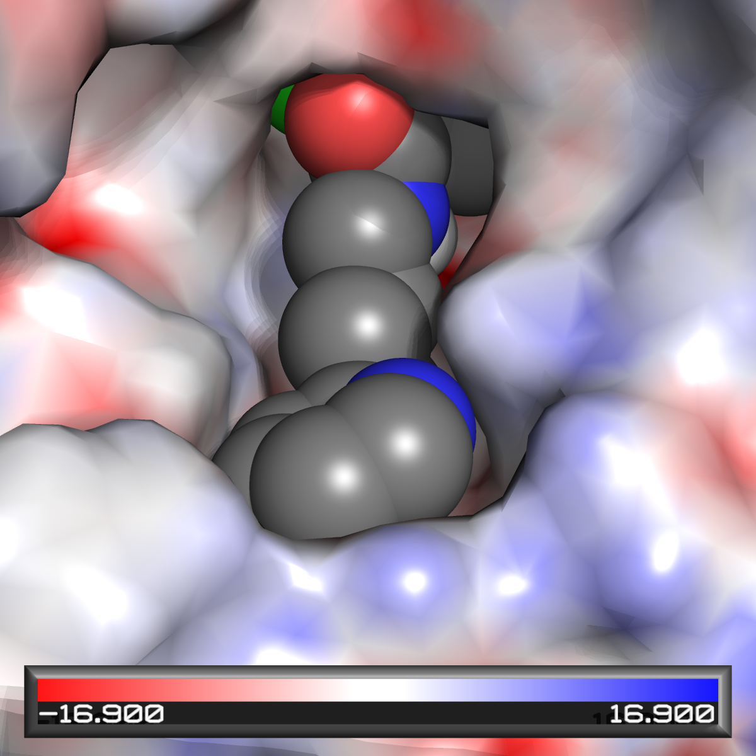
Check results for:
Shape fitting
Mismatches
Polar interactions
Contribution to binding
Notes:
The contribution of specific interactions to binding is the exact opposite to the strength of the interaction.
Van der Waals are most crucial for ligand binding, since they are the most numerous.
Salt bridges are very rare in drug molecules and therefore contribute the least to their binding.
It is impossible to calculate van der Waals interactions manually, but we can look for shape fitting.
The greater the contact area between receptor and ligand, the stronger these interactions will be.

